Slide 1
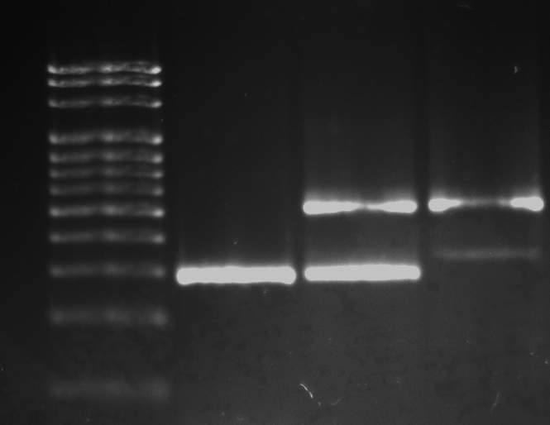
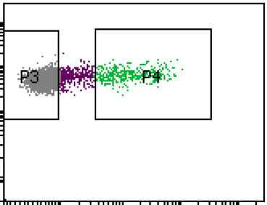
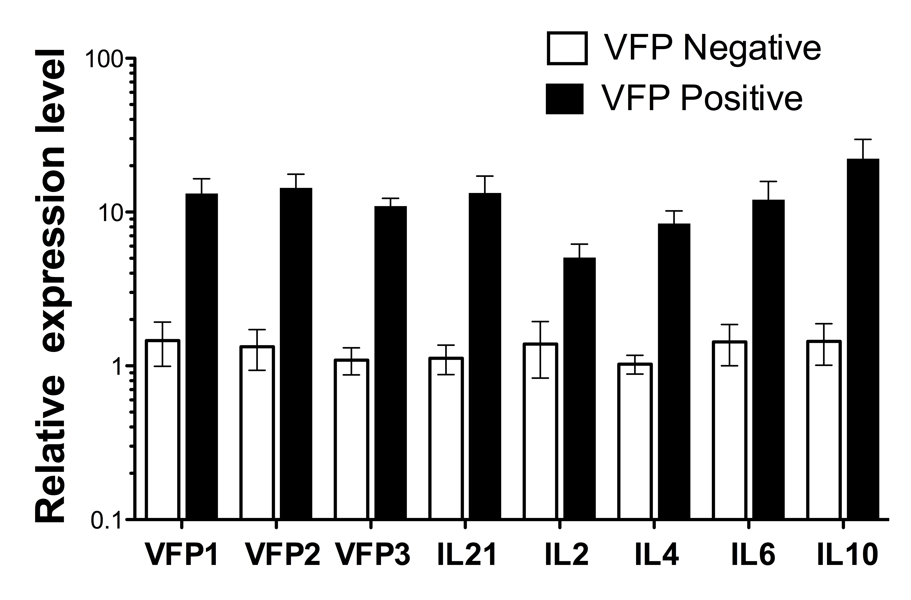
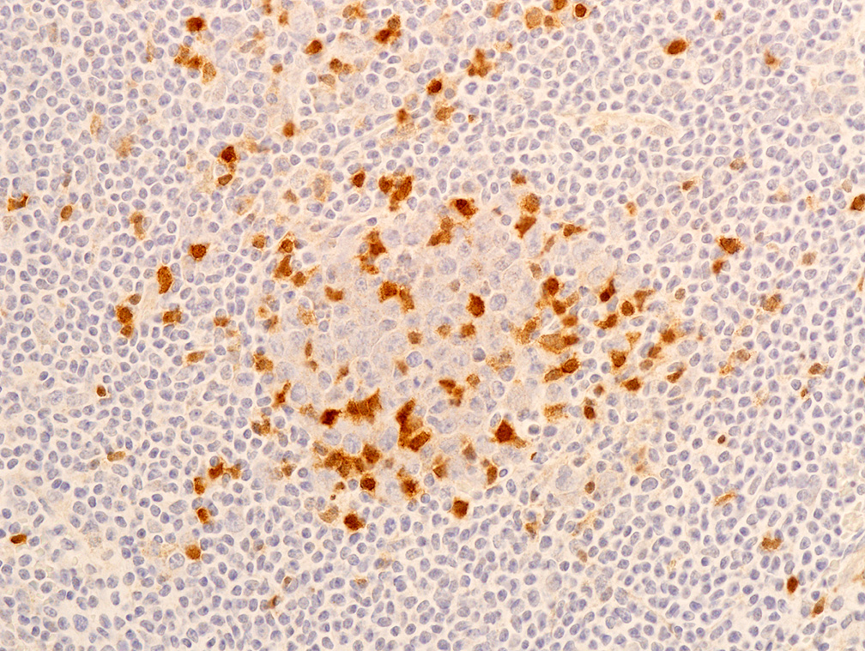
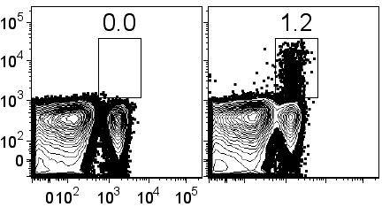
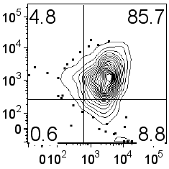
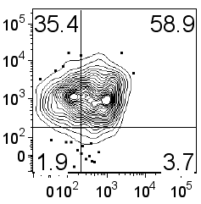
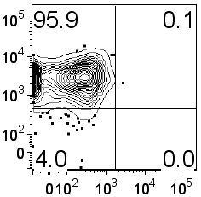
Supplemental Figure 1
A
B
100
bp ladder
B6
VFP
het
VFP
hom
C
Start
5’ homology arm
Stop
3’ homology arm
1200
1100
1000
1
2
3
5
loxP
Neo
loxP
5 (split)
4
IRES
VFP
PGK
pA
900
800
700
600
500
400
300
200
100
Start
Stop
X Cre mouse
1
2
3
4
5
IRES
VFP
5 (split)
PGK-Neo excised
CD4
D
VFP
F
E
B6 Control
B6.IL21-VFP
VFP
ICOS
CD44
ICOS
CD4
CD44
PD1
NK 1.1
Notes:
Supplemental Figure 1
In vitro & In Vivo IL21 reporter validation. (a) IL21-VFP reporter construct design. An IRES-VFP cassette was inserted into non-coding exon 5 of Il21 along with a Neo^{R} selection cassette flanked by loxP sites. After insertion the Neo^{R} cassette was excised by cre-mediated deletion resulting in mice containing the IRES-VFP reporter. (b) PCR confirms the excision of the Neo^{R} cassette with the proper band lengths being seen that distinguish wild type and IL21-VFP reporter mice. (c) To verify accurate reporter expression splenocytes from IL21-VFP mice were cultured in vitro with antibodies to CD3 and CD28. FACS performed 24hrs later confirmed increased numbers of VFP⁺CD4⁺ and activated ICOS⁺CD4⁺ T cells compared to cultures prior to stimulation. Cells were then sorted as being VFP⁻ or VFP⁺. RT-qPCR analyses of the sorted cells showed that the cells sorted as being VFP⁺ expressed equivalent levels of the VFP and Il21 transcripts. (d) IL21-VFP mice were immunized with DNP-KLH in CFA and analyzed 11 days later. Mice were compared to an unimmunized standard B6 mouse for gating controls. FACS showed that the CD4⁺ population had the highest frequency of VFP⁺ cells. (e) Further flow analysis shows that the CD4⁺ VFP⁺ cells were predominately ICOS⁺ and PD1⁺. (f) CD4⁺ cells were then analyzed for Gr1+ and NK 1.1⁺. Neither population showed appreciable numbers of VFP⁺ cells. (g) Cells were then FACS sorted as being VFP⁻ VFP^{lo} or VFP^{hi}. (h) RT-qPCR on VFP^{hi} sorted cells demonstrated increased Il21 transcripts compared to VFP⁻ cells, as well as increased expression of other cytokines.(i) Immunohistochemical staining using anti-GFP/VFP of spleen sections from B6 Sle1 yaa VFP mice showing localization of VFP to the germinal center (circled area).

Slide 2
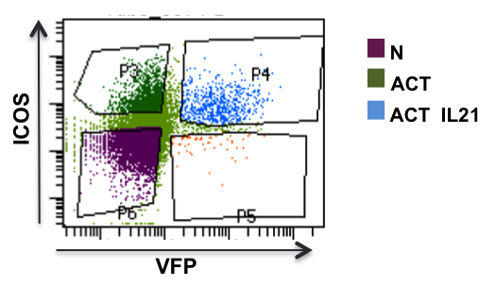
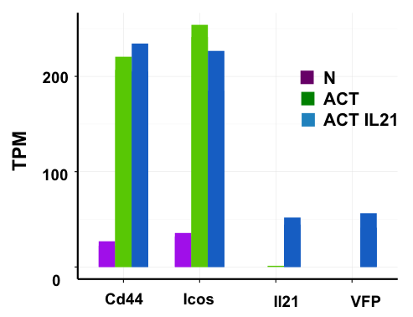
Supplemental Figure 2
a
b

Slide 3
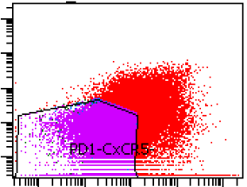
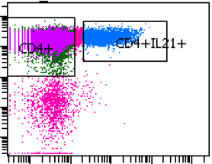
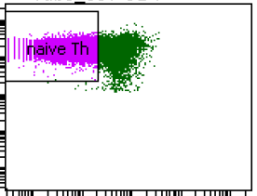
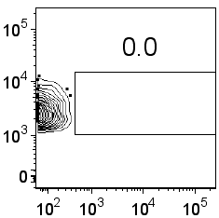
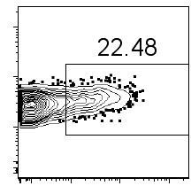
Supplemental Figure 3
a
nT_{FH}
naive
PD1
CD4
CD4
CXCR5
IL21
CD44
b
c
Negative Control
Recipient
CD4
VFP

